Slide 1

Fiverr Platform
Empowering Freelancers and Clients

Slide 2
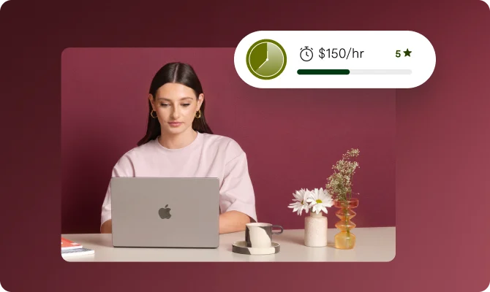
Presented by: . Từ Mận Hào . Phạm Minh huy
Date: 2024-09-11

Slide 3
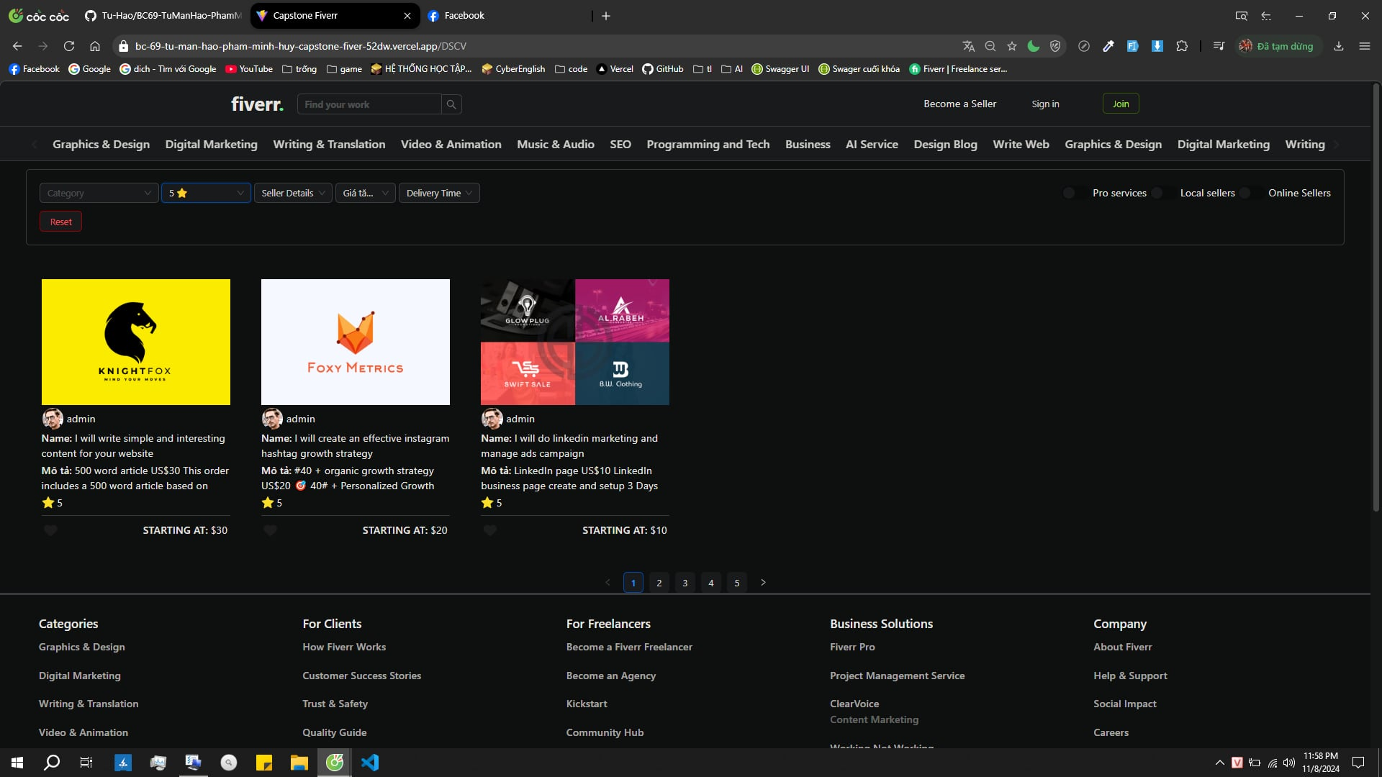
Project Overview
Introduction:
Fiverr is a feature-rich platform designed using ReactJS and TypeScript.
Aims to create a marketplace where freelancers and clients seamlessly connect.
Main Goal: Provide a reliable and user-friendly environment for hiring and managing freelance work.

Slide 4
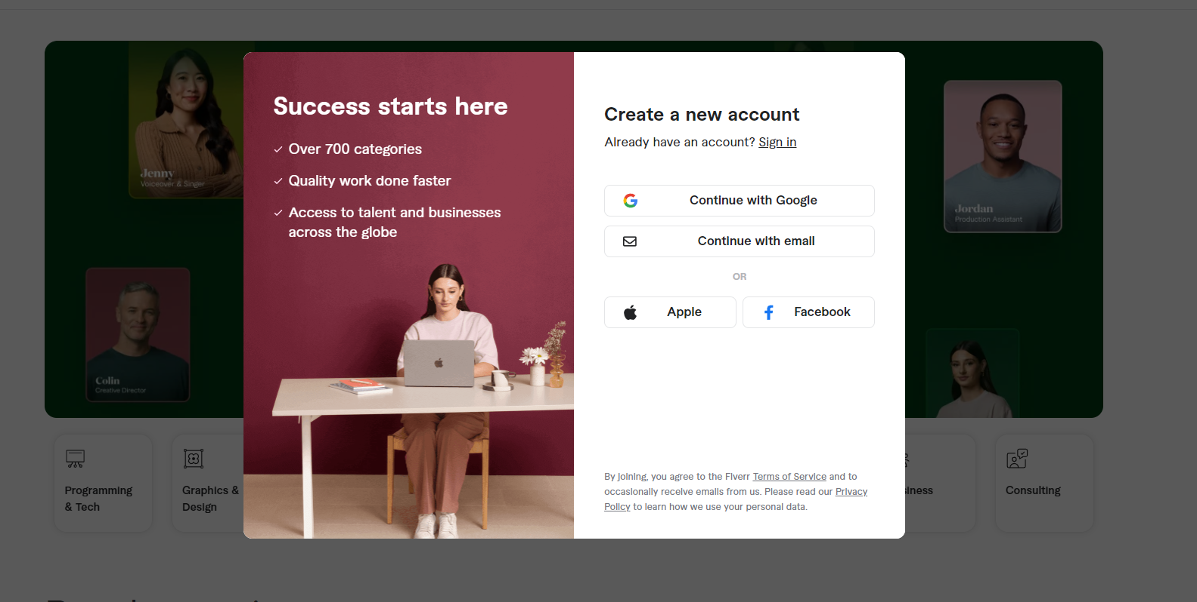
Key Features
User Registration and Login:
Quick and secure sign-up and login for a smooth user experience.
Job Search and Display:
Users can easily browse, search, and view job listings tailored to their needs.
Job Hiring and Management:
Intuitive workflow to hire, view ongoing jobs, and manage job progress.

Slide 5

Interactive User Features
Profile Management:
Users can update their profile details, including avatar, bio, and skills, ensuring an up-to-date presence on the platform.
Ratings and Reviews:
Clients can provide ratings and feedback, building a trust-based system.
Job History:
Users can access a personal dashboard to see hired and completed jobs, helping track their freelance journey.

Slide 6
Administrative Controls
Admin Dashboard:
A comprehensive interface for managing the platform, ensuring quality and consistency.
User and Job Management:
Admins can create, read, update, and delete users and jobs.
Focus on Usability:
Eye-catching design and intuitive layouts make it easy for admins to maintain platform standards.

Slide 7



Technology Stack
Frontend
Backend
Styling
Secure and efficient API integrations for user management and job handling.
ReactJS with TypeScript for robust, type-safe development.
Tailwind CSS, Ant Design providing responsive and beautiful UI components.

Slide 8
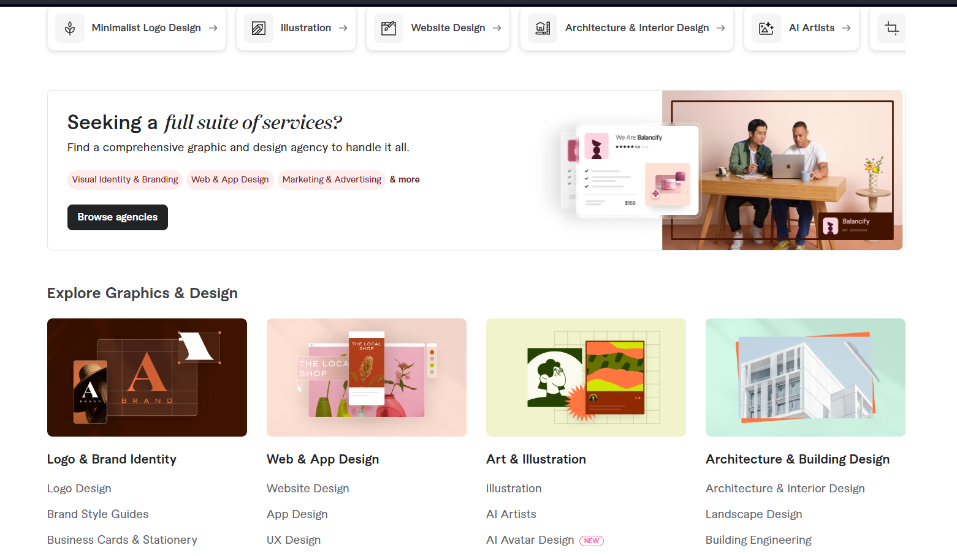


User Interface
Modern and Accessible Design
User-Centric Layouts:
Clean, visually appealing interface optimized for all devices.
Every component crafted to be both functional and delightful, from job cards to profile sections.

Slide 9


Future Potential
Continually enhance features to make Fiverr an even more attractive space for collaboration.
Vision
freelancer
Expand on user feedback, enhance security, and introduce new tools to support freelancers’ diverse needs.
Jack
user

Slide 10



Unique Value Proposition
Why Fiverr?
Family and Flexibility Focus
Our platform aims to be a paradise for freelancers, allowing them the flexibility to work on their own terms.
For clients, Fiverr provides access to a vast talent pool, making it easier than ever to find the right professional for any project.
Designed for those who want to balance their career aspirations with family time and personal commitments.

Slide 11

Q&A and Closing Remarks
Open floor for questions.
Reiterate Fiverr's mission to bridge the gap between freelancers and clients, empowering them to achieve more together.

Slide 12

Thank you !

